Slide 1
Polar actions on complex hyperbolic spaces
Joint work with J. C. Díaz-Ramos and A. Kollross
Miguel Domínguez Vázquez
Instituto de Matemática Pura e Aplicada

Slide 2
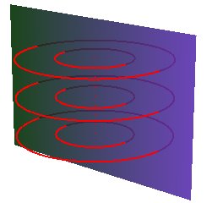
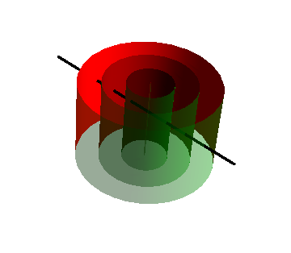
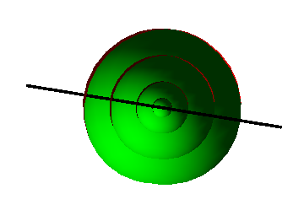
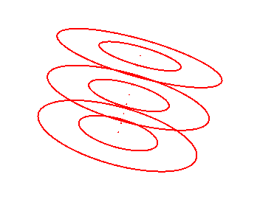
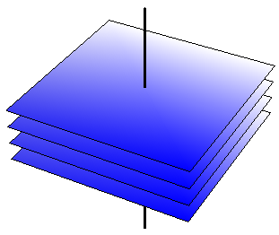
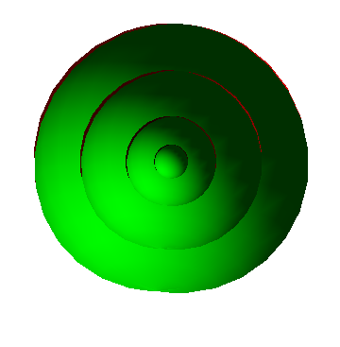
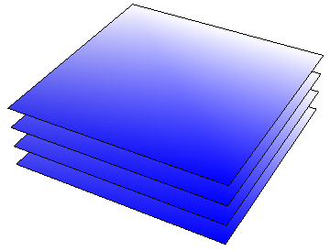
Symmetry in submanifold theory

Slide 3
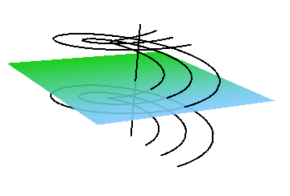
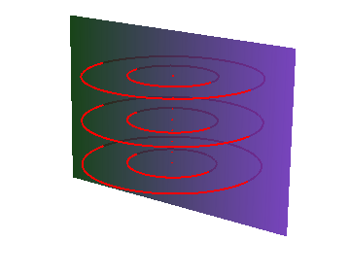
Polar actions
Definition

Slide 4
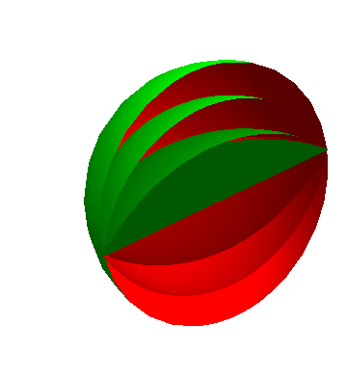
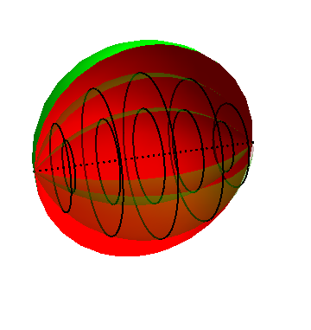
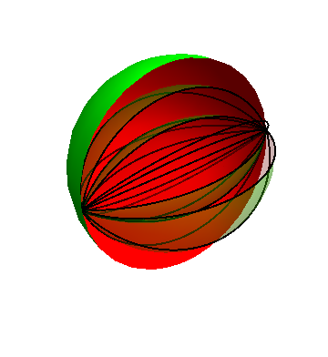
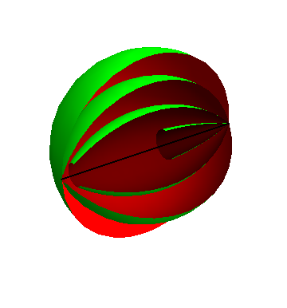
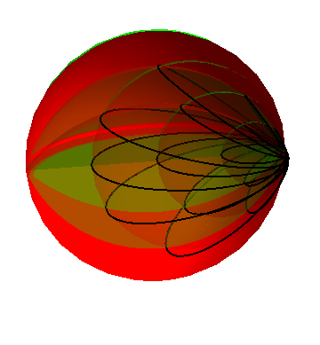
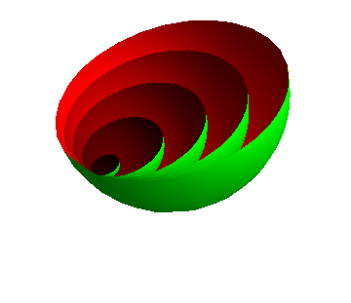
Polar actions
Previous classification results

Slide 5
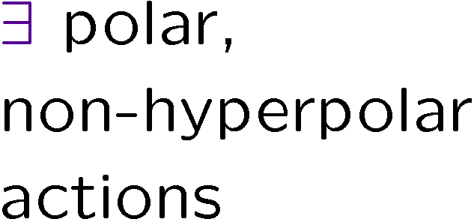
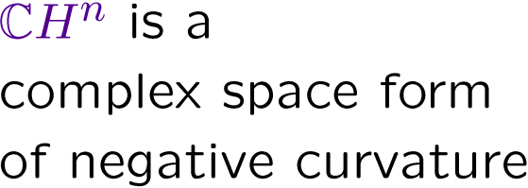
Polar actions
Previous classification results

Slide 6
Polar actions on CH^{n}
Sketch of the proof

Slide 7
Polar actions on CH^{n}
Sketch of the proof

Slide 8
Polar actions on CH^{n}
Sketch of the proof

Slide 9
Polar actions on CH^{n}
Sketch of the proof

Slide 10
Polar actions on CH^{n}
Classification theorem

