Slide 1
The maximal existence condition of Ricci parallel Hopf real hypersurfaces in complex Grassmannians of rank two
Author: Young Jin Suh & Changhwa Woo*
Affilation: Kyungpook National Univ. & Pukyong National Univ.*
Date: 28 October 2019
Place: Universidade de Santiago de Compostela
Santiago de Compostela Spain

Slide 2
Contents
1
Ambient space
2
Motivation
3
Problems
4
Real hypersurfaces
5
Parallel Ricci tensor
6
Results

Slide 3
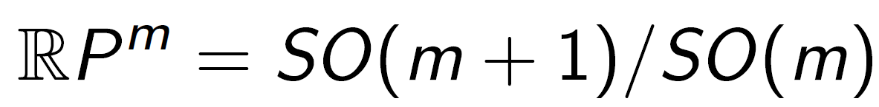
Grassmannians of rank 1
= Projective space

Slide 4
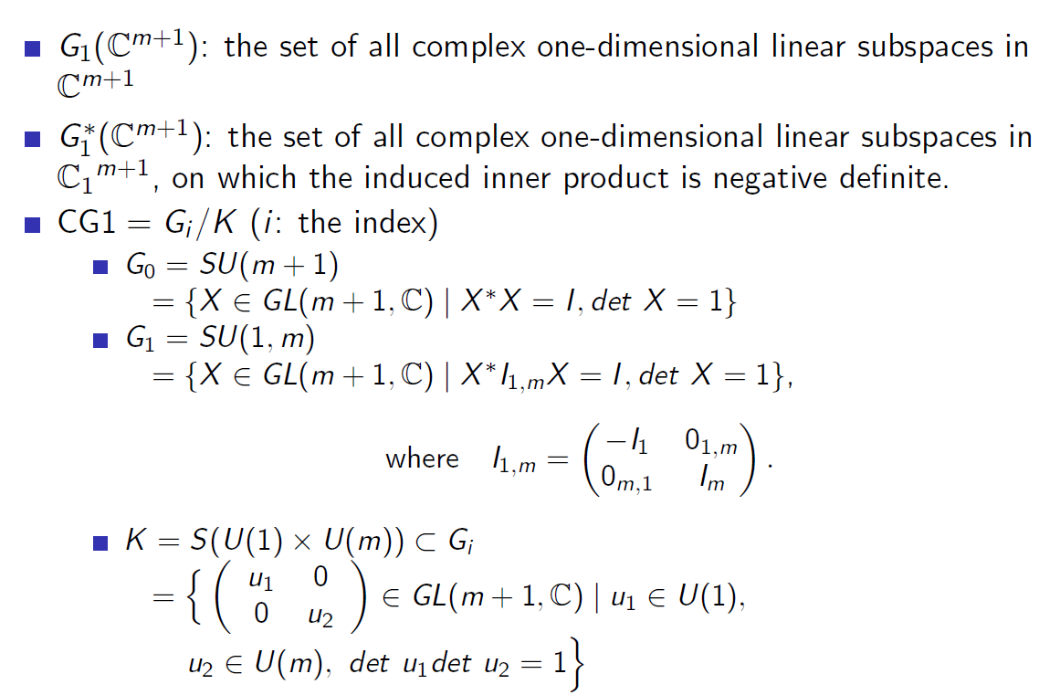
Complex Grassmannians of rank 1

Slide 5
Complex Grassmannians of rank 2

Slide 6
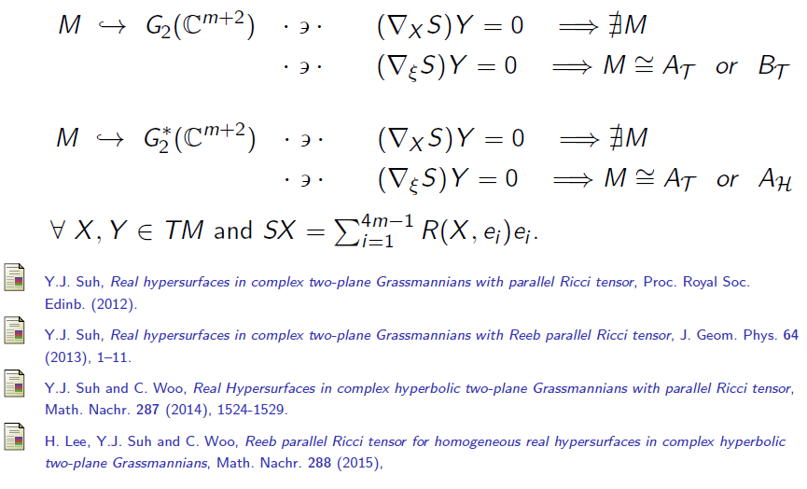
Motivation

Slide 7
Problems

Slide 8
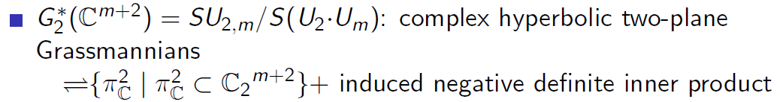
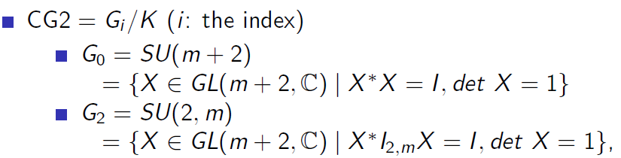

Complex Grassmannians of rank 2

Slide 9






Real hypersurfaces in CG2
$$N:normal vector field$$
$$p∈M$$
$$Real hypersuface M$$

Slide 10
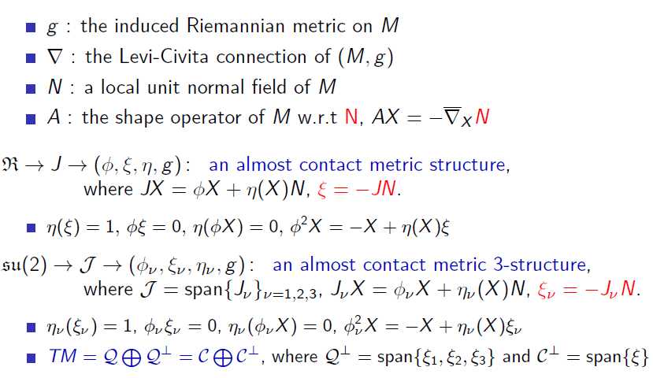
Real hypersurface in CG2

Slide 11
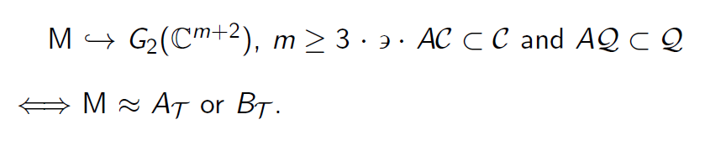
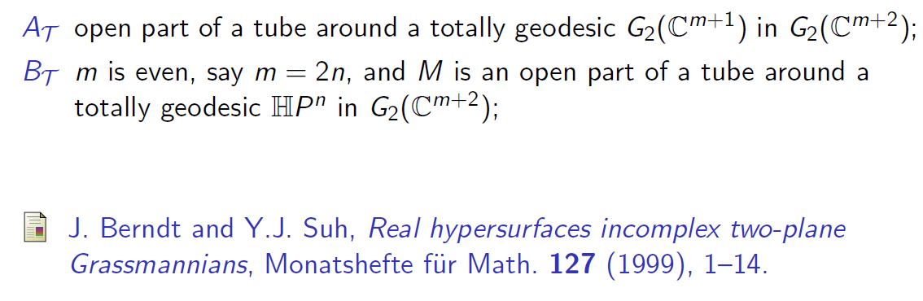
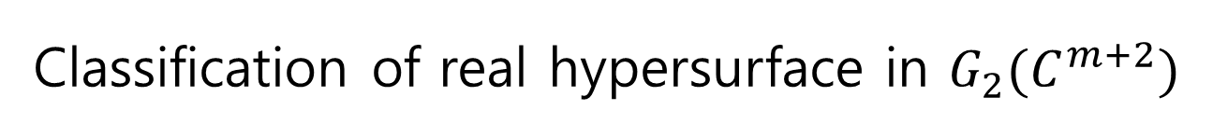
Classification of real hypersurface in ${G_{2}(C}^{m+2})$

Slide 12
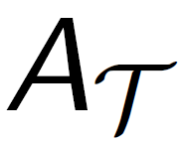
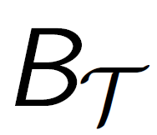







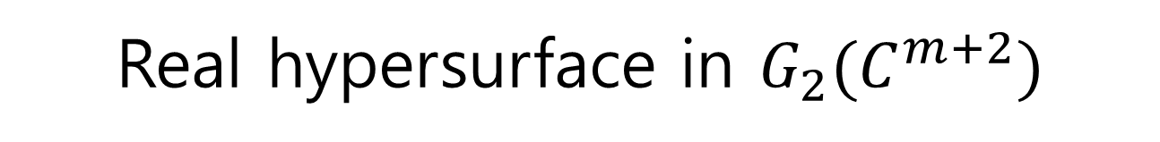



Real hypersurface in ${G_{2}(C}^{m+2})$
$$Radius \frac{π}{2√2}−r$$
$$Radius \frac{π}{2}−r$$
$$Distance \frac{π}{2√2}$$
$$Real hypersurface M$$
$$Distance \frac{π}{2}$$
$$Radius r$$

Slide 13
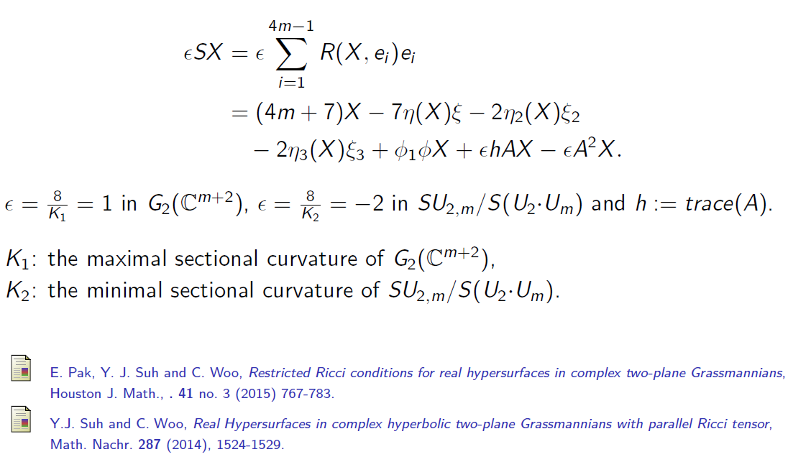
The Ricci tensor of M in CG2

Slide 14
Problems

Slide 15
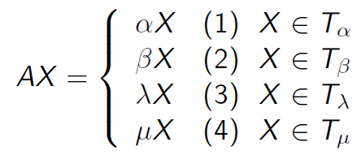
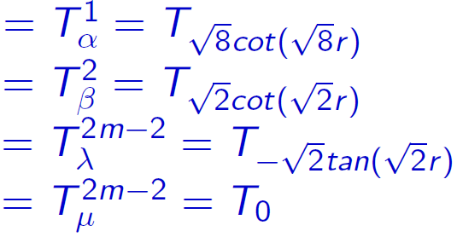
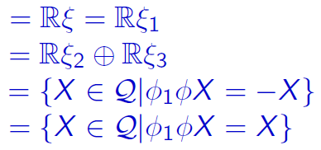
Proposition A

Slide 16
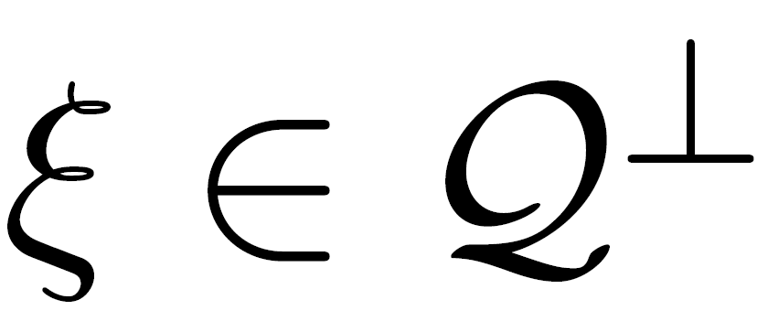


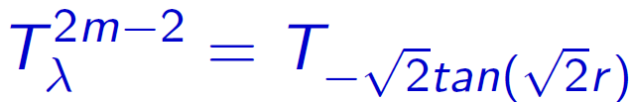




$$Radius r$$
$$Distance \frac{π}{2√2}$$
$$Radius 0<r<\frac{π}{2√2}$$

Slide 17



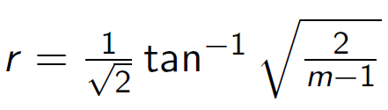



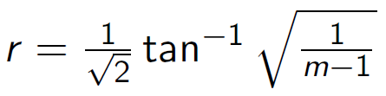



Slide 18
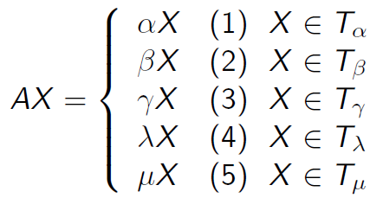
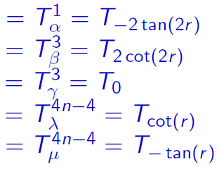
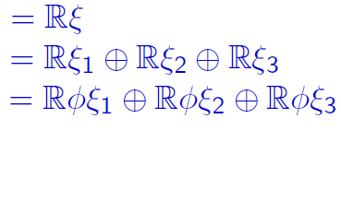
Proposition B

Slide 19



$$Radius r$$
$$Distance \frac{π}{2}$$
$$Radius 0<r<\frac{π}{2}$$

Slide 20






Slide 21
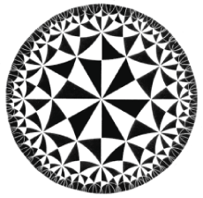




Hadamad mfd:
Hyperbolic space
$$Geodesic ‼$$
$$\{∞\}$$
$$\{∞\}$$
$$NoT Geodesic ‼$$

Slide 22







Real hypersurface in ${G_{2}^{∗} (C}^{m+2})$
$$N:normal vector field$$
$$∞−boundary$$
$$T_{p}M at point p∈M$$
$$p∈M$$
$$ξ=−JN$$
$$∞−boundary$$
$$Real hypersurface M$$

Slide 23
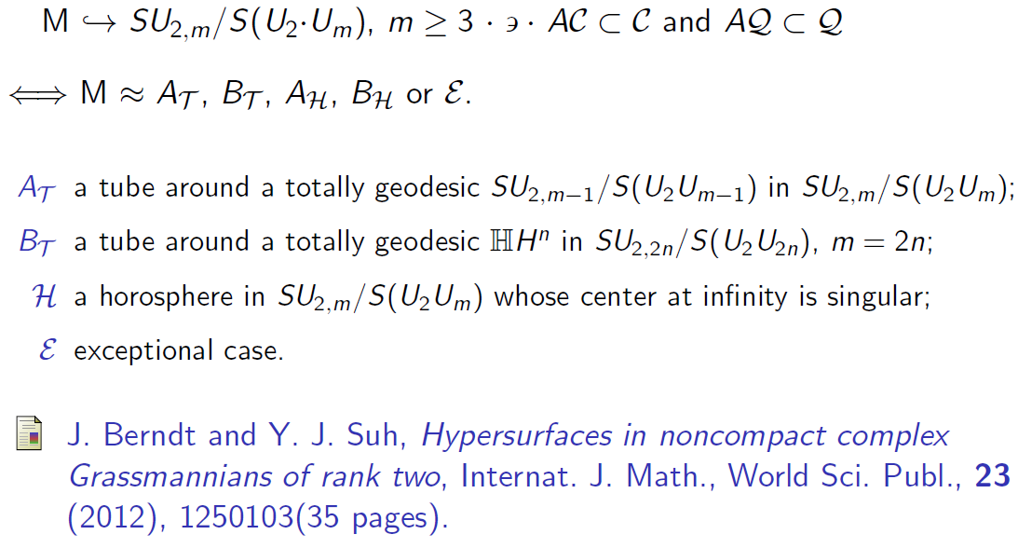
Real hypersurface in ${G_{2}^{∗} (C}^{m+2})$

Slide 24
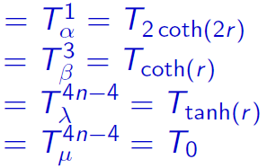
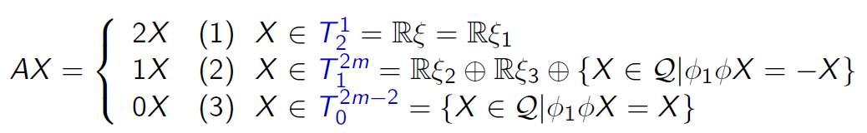

Proposition C

Slide 26


Slide 27
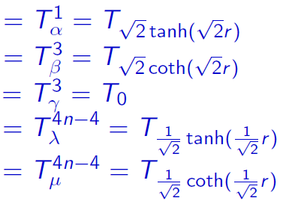
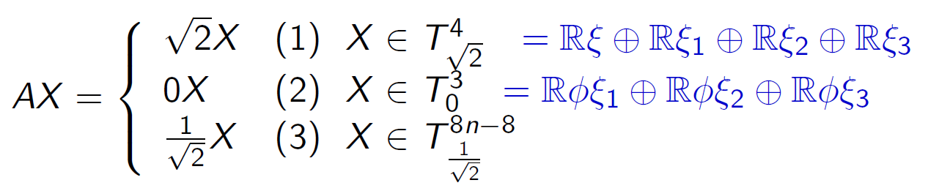
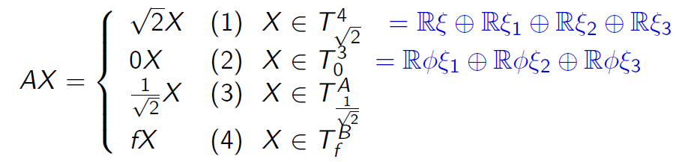

Proposition D

Slide 28
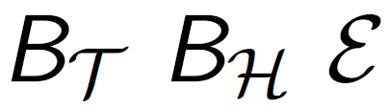

Slide 29
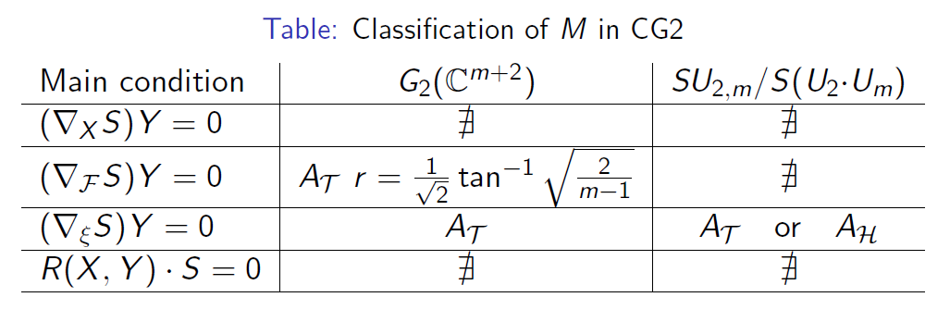
Results

Slide 30


